Slide 1
Space Hunter D
By Israel Dauda

Slide 2
Game Overview
Space Hunter D is a 2D action platformer in which you fight 7 Pirate Lords that have taken over seven different planets in the Solaris System.
Defeat them and use their insanely powerful and unique weapons to save the galaxy…and collect a lot of money!

Slide 3
Action Platforming
Exploration
Rewards
Player Expression
Design Pillars
Unique levels are centered around a specific gimmick based off the respective planet.
Adept players will simultaneously fight enemies while doing tight, precisive platforming.
Collectibles such as weapon, armor and ability upgrades are hidden throughout the levels.
Curious players are rewarded for thorough exploration with augmented abilities and weapon upgrades.
Levels can be selected in any order the player chooses allowing for variety in repeated playthroughs and unique experiences.
Ingenious players can use any weapon they wish in order to tackle different situations in the levels.

Slide 4
Gameplay Loop
Select A Planet!
Choose any of the 7 pirate lord bounties you want to take on!
Obtain New Weapon!
Fight Your Way Through!
Defeating the boss will allow you to obtain and use their signature weapon against other enemies!
You’ll fight all sorts of tough and dangerous enemies as you run, jump and shoot your way through the level!
Defeat The Boss!
Learn, adapt and overcome the boss’ brutal attack pattern in order to defeat them.

Slide 5
Minimum Viable Product
Tutorial Level
Simple enemy AI
  Flying Turret Enemy
  Tutorial Boss - Simple Stomping Robot
Weapons
  Rapid-fire
  Bomb
  Shotgun
Weapon Wheel
HUD
  Health
  Ammo Count
  Current Weapon Equipped

Slide 6
Narrative
In the year 40XX, mankind has outgrown their backwater earthly cradle and have taken off to the Outer Cosmos in order to explore the vast, mysterious new galaxies and inhabit the unique planets that lie within. You play as D, a less-than-stellar bounty hunter that finds all sorts of rogue aliens and turns them in dead or alive for cold hard cash. All is relatively peaceful in the Cosmos until D receives an alert from the Space Colony Enterprise about the notorious space pirate Blackbeard and his 7 Pirate Lords that have taken over several planets within the Solaris System. It’s up to him to defeat the Pirate Lords, put an end to Blackbeard’s conquest and save the galaxy!

Slide 7
Enemies
Knowing which type weapon best fits the situation at hand is the key to survival!
Analyze the scenario, equip the right weapon and act accordingly!
Enemies in each stage are divided into 3 types:
Swarmers - Will usually run towards the player to deal contact damage
Shooters - Stationary enemies that fire projectiles at the player
Bruisers - These enemies are tanky, mixed attackers that run and/or shoot at the player.

Slide 8
Bosses
At the end of each level, players will come face to face with one of the 7 Pirate Lords.
The Pirate Lords all wield devastating and powerful weapons that can make short work of the player if they don’t carefully memorize their attack patterns.
While the Pirate Lords are insanely powerful, they’re purposefully designed to have very predictable movements and attack patterns in order for the player to feel challenged and not frustrated.

Slide 9
Weapons
Each of the 7 Pirate Lords have their own unique weapon that D will have to deal with in battle.
Analyzing the boss’ attack patterns and movements will be the key to D’s survival and procurement of their respective weapon.
Killing a certain number of enemies with the unique weapon will cause it to undergo a Weapon Transformation which augments its stats and abilities.

Slide 10
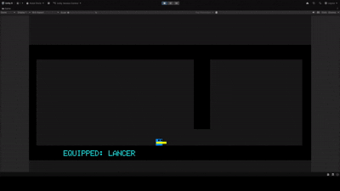
Lancer
The Lancer is a low-damage, high-output automatic weapon that ricochets off walls in order to mercilessly bombard enemies with extreme prejudice.
Once upgraded it becomes the Heavy Lancer. Its rate of fire becomes faster and the amount of time bullets can bounce for increases.

Slide 11
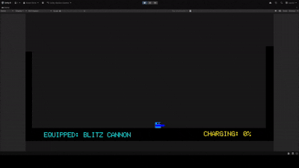
Blitz Cannon
The Blitz Cannon high-damage, low-output weapon that has two modes of firing, Semi-Auto and Charge. Semi-Auto Mode fires out red streams that can deal a considerable amount of damage to enemies but in Charge Mode, the streams turn blue and can deal colossal damage, taking out some enemies in one hit!
Once upgraded it becomes the Hell Cannon. The range and charge rate are increased and the streams can pierce through walls and enemies.

Slide 12
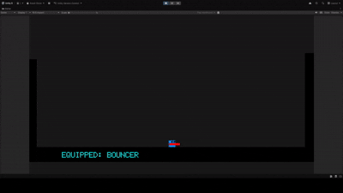
Bouncer
The Bouncer is a high-damage, low-output grenade launcher that fires out a giant payload which explodes on contact with enemies. After the initial explosion, smaller bomblets are spawned which bounce towards enemies before exploding.
Once upgraded it becomes the Adjudicator. The main payload explosion is bigger and the number of bomblets increase.

Slide 13

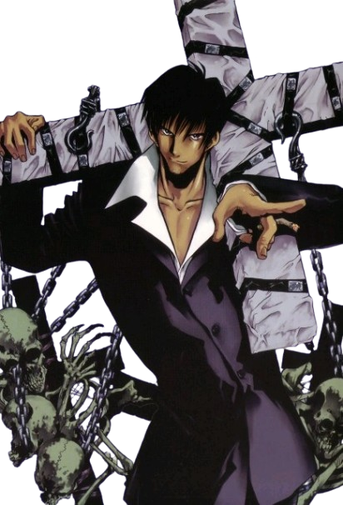


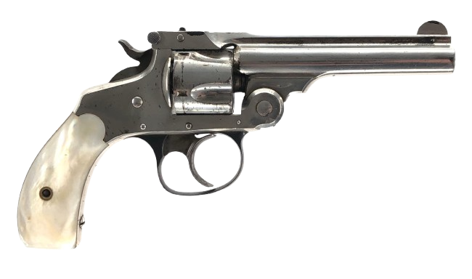

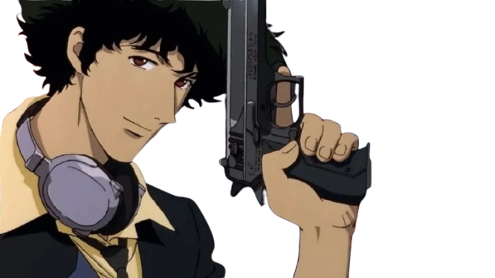
D - Moodboard
Notes:
The idea I have for D is that, appearance-wise, he’s this scruffy, sort of unkempt but cool looking guy in his early 30s.
He’s seen and fought all sorts of creatures and aliens and it’s clearly taken a toll on him.
He’s an anti-hero that really only cares about saving the day if there’s money to be made.
He generally won’t resort to underhanded tactics unless he really has to and is the kind of guy that enjoys a good drink and a smoke to take the pressure off.

Slide 14
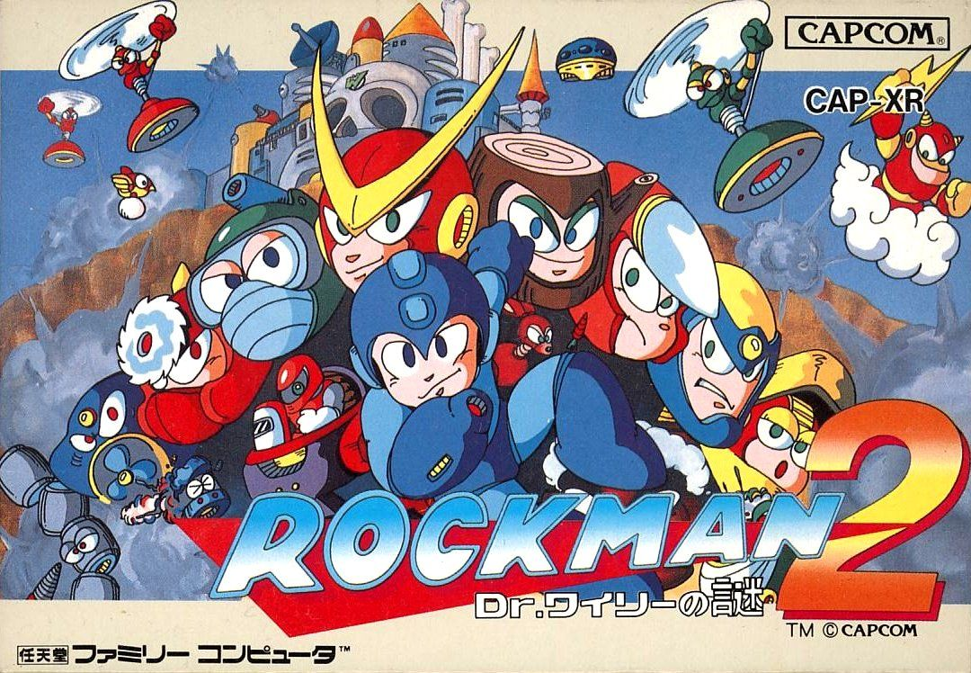
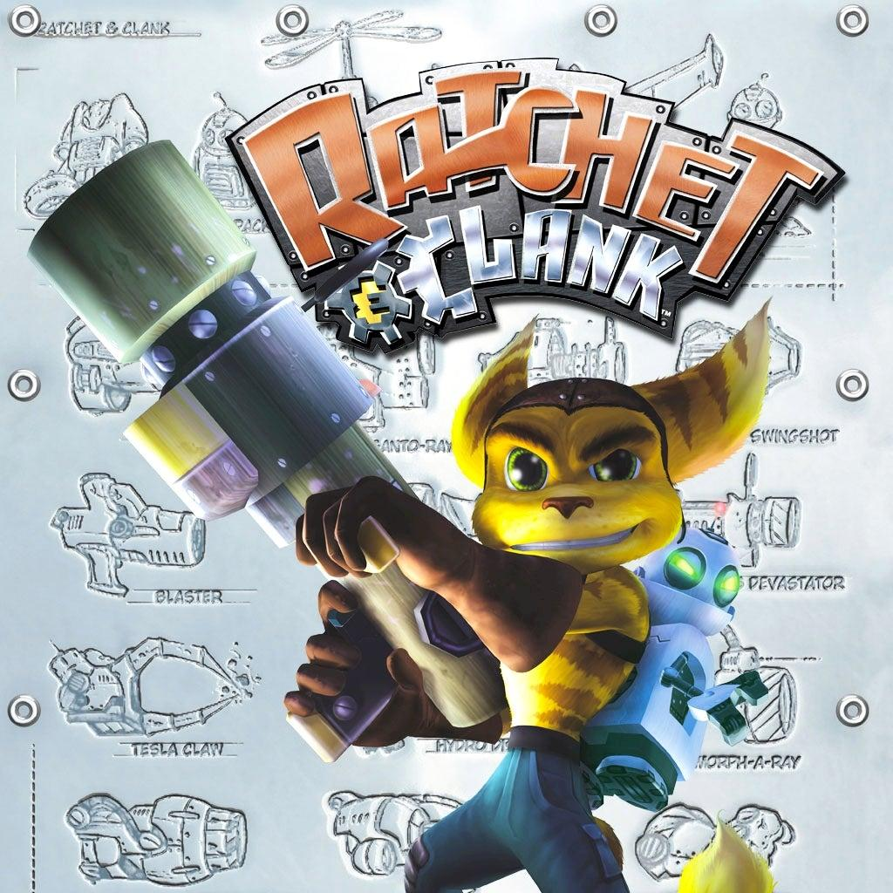
Influences
My two biggest influences are Rockman and Ratchet & Clank.
Both of these games have unique weapons for you to use against enemies and test your knowledge on which weapon works for the right situation.
Rockman’s story is very simplistic, you fight 8 robot masters and stop Dr.Wily from taking over the world.
Ratchet & Clank has you going on adventures across the Solana Galaxy where you explore all sort of unique planets and obtain insane weapons.

Slide 15
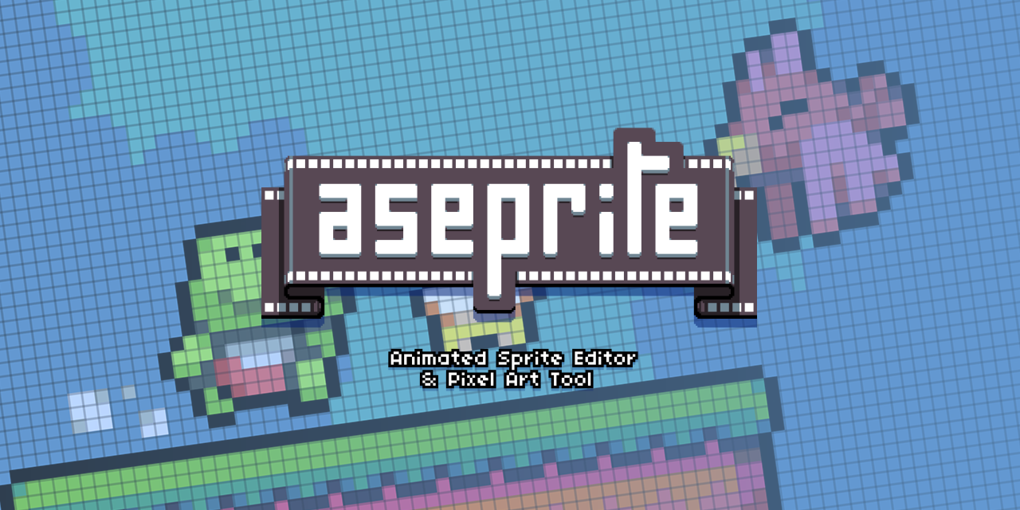
Artstyle
For the artstyle I want to harken back to the NES era. The sprites were simple but the colors used were extremely expressive.
I already have Aseprite so I’ll using very minimal resolutions for the characters. This will make it easier to animate as there’s less moving parts to account for.

Slide 16

Music
Space Hunter D’s music will be mostly chiptune tracks that will be produced in FL Studio. The tracks for each planet should be high energy with simple melodic loops that make it catchy.

Slide 17
Reflection
The purpose of this game is to demonstrate my skills as a programmer and designer. I want to theorize gameplay concepts on paper and see how I can implement them into a game engine of my choice. I’ve chosen Unity as I have the most experience making games on it. I understand Unreal Engine 5 is usually seen as a better alternative that can make your games look pretty but I’ll stick with Unity as it’s not too stressful on my laptop’s CPU and I have a much easier time implementing C# code into the engine.
By using Rockman’s gameplay as a template, it helps keep my project within a small scope as the main bulk of the design goes into weapon mechanics, enemy AI and level design. With this being a solo project, I will need to create a robust schedule so that I can publish the game on itch.io within a realistic timeframe. I want to make frequent updates on what I’ve added in the form of video dev logs so that potential employers can understand my design thought process if they become invested in my project.

